Slide 1
Chapter 7
Templates

Slide 2
Objectives
Introduction
Function Templates
Class Templates
Standard Template Library

Slide 3
Introduction
Templates is a facility provided by the C++ language to write a common function that is independent of a data type but which embodies the common algorithm and that the C++ language on its own creates the actual function as and when the need arises.
Advantages: ease in code development and ease in code maintenance.
The programmer can create a template with some or all variables therein having unspecified data types.
Whenever the template is invoked by passing arguments of a certain type, the C++ language on its own replaces the unspecified type with the type of the arguments passed. Such templates can be created for individual functions as well as entire classes.
Templates are used for creating family of classes or functions.
Example of templates is given for the swap function in Examples 1 and 2.

Slide 4
Introduction
Example 1: Swapping two integers
void swap_values(int & v1, int & v2)
{
int temp;
temp = v1;
v1 = v2;
v2= temp;
}
Example 2: Swapping two characters
void swap_values(char & v1, char & v2)
{
char temp;
temp = v1;
v1 = v2;
v2 = temp;
}

Slide 5
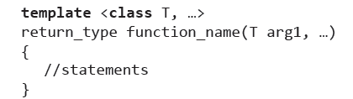
Function Templates
The syntax for creating a template for a generic function is given below:
The template definition begins with the template keyword.
This is followed by a list of generic data types in angular brackets.
Each generic type is prefixed with the class keyword and, if the template function works on more than one generic type, commas separate them.
Thereafter, the function template is defined just like an ordinary function. The return type comes first.
This is followed by the name of the function, which in turn is followed by a pair of parentheses enclosing the list of formal arguments the function takes.

Slide 6
Function Templates
However, there should be at least one formal argument of each one of the generic types mentioned within the angular brackets.
As an example, consider the template for the function swap.
Example 3: Template for function swap()
Type parameter
template<class T>
void swap(T& v1, T& v2)
{
T temp;
temp = v1;
v1 = v2;
v2 = temp;
}

Slide 7
Function Templates
When the function swap is called by passing two integers, the compiler generates an actual definition for the function by replacing each occurrence of T by the keyword int. (See Example 4).
Example 4
void main()
{
int x,y;
x=5; y=10;
cout<<“before swapping\n”;
cout<<x<<“t”<<Y<<endl;
swap(x,y);
cout<<“after swapping\n”;
cout<<x<<“t”<<Y<<endl;
}

Slide 8
Function Templates
Similarly, if the function swap is called by passing two floats, the compiler generates an actual definition for the function by replacing each occurrence of T by the keyword float. (See Example 5).
Example 5
void main()
{
float x,y;
x=5; y=10;
cout<<“before swapping\n”;
cout<<x<<“t”<<Y<<endl;
swap(x,y);
cout<<“after swapping\n”;
cout<<x<<“t”<<Y<<endl;
}

Slide 9
Function Templates
Objects of classes can also be passed to the function swap. The compiler will generate an actual definition by replacing each occurrence of T by the name of the corresponding class. (See Example 6).
Example 6
void main()
{
distance d1(4,7.5), d2(5,9.5)
cout<<“before swapping\n”;
cout<<d1.feet<<“t”<<d1.inch<<endl;
cout<<d1.feet<<“t”<<d1.inch<<endl;
swap(d1,d2);
cout<<d1.feet<<“t”<<d1.inch<<endl;
cout<<d1.feet<<“t”<<d1.inch<<endl;
}
Advantages of templates: It implements code reusability thus saving a lot of effort in code development.

Slide 10
Function Templates
The compiler generates an actual function from a template only once for a given data type. Subsequent calls with the same data type will not generate the definition again.
This is because the compiler first looks for an exact match to resolve a function call before looking for a template. If it finds an exact match, it does not look for a template. Since the first function call itself generates the function definition, subsequent calls do not do so.
The entire definition of the function must appear in the header file. Otherwise, the compiler would not be able to generate the correct definition while compiling a user program in which the function template has been called.

Slide 11
Function Templates
It is sometimes necessary to override the function template by an actual function.(See Example 7).
Example 7 : Template for larger function
template<class T>
T& larger(const T& v1, const T& v2)
{
return a>b? a:b;
}
This works for variables of ordinary data types, however, it does not work correctly if strings are passed to it. (See Example 8).
Example 8 : Calling the larger function by passing strings
char *s1 = “abcd”, *s2=“mnop”;
char *s3=larger (s1,s2);
This is because only the addresses of the two strings and not their contents are compared by the larger function.

Slide 12
Function Templates
For the character strings to execute, a special version of the function larger could be defined along with the template. (See Example 9).
Example 9 : Overriding the template for the function larger
char * larger (char *a, char *b)
{ return strcmp(a,b)> 0 ? a:b;
}
If the function larger is called by passing two strings, the function in Listing Example 8 will be called while the template will be ignored.

Slide 13
Function Templates
Function templates can be overloaded. (See Example 10).
Templates can be overloaded either by using template functions or ordinary functions. In that case, compiler looks for exact match in ordinary function first, if it is not matching then it looks for template function having exact match. An error will be generated if there is no match
Example 10:
template<classT>
void disp (const T &a)
{
for (int i=1; i<=20; i++)
cout<<a;
}
template<class T>
void disp (const T &a, const int no) //overloaded version of disp()
{
for (int i=1; i<=no; i++)
cout<<a;
cout<<endl; }

Slide 14
Function Templates
Function template can be used to sort an elements (See Example 11).
Example 11: Template for bubble sort
template <class Item>
void bubble_sort(Item data[ ], int n)
{
int i, j;
Item temp;
for(i = 0; i < n-1 ; i++)
{
for(j= 0; j< n-i-1 ; j++)
{
if(data[j] > data[j+1])
{
temp = data[j];
data[j] = data[j+1];
data[j+1] = temp;
}
}
}

Slide 15
Function Templates
More than one generic type also be mentioned in the template definition.
Example 12:
template<classT1,classT2>
void disp (T1 x, T2 y)
{
cout<<“displaying:”<<“x=“<<x<<“\ty=“<<y;
}

Slide 16
Class Templates
The need for class templates stems from the frequent need for generic classes (Queue, Stack, Array, etc.) that handle data of different types.
Consider the set of two classes whose member functions have similar definitions, the mere difference being the type of the private data members upon whom they operate:
Example 11: Classes with similar definitions
class Integer
{
int i;
public :
void f1(const int &);
void f2(const int &);
//rest of the class
};
class Character
{
char i;
public :
void f1(const char &);
void f2(const char &);
//rest of the class
};

Slide 17
Class Templates
The presence of two or more different classes that are different only in the data type of the data members upon whom their member functions work creates huge difficulties in code maintenance. Any change in one of the classes will have to be replicated in all of the others. This situation certainly demands the creation of a template class. (See Example 14).
Example 14
template <class T>
class X
{ T val;
public:
void f1(const T &);
void f2(const T &);
//rest of the class
};

Slide 18
The definition of the template class begins with the keyword template.
This is followed by the list of type and non-type template arguments enclosed in angular brackets.
Type template arguments are those that represent a data type. An actual built-in or user-defined type replaces them when an object is declared.
Class Templates
Each type template argument is preceded by the keyword class.
Non-type template arguments are variables of built-in or user-defined type.
Actual constant values are passed for these non-type template arguments.
The data type precedes each non-type template argument.
Thereafter, the class is defined using the usual syntax.

Slide 19
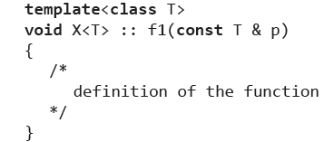
Class Templates
Member functions of a template class are defined in the same way as the template class itself. (See Example 15).
Example 15
The definition begins with the template keyword.
This is followed by the list of type and non-type template arguments enclosed in angular brackets.
Each type template argument is preceded by the keyword class; each non-type template argument is preceded by its data type.

Slide 20
Class Templates
Thereafter, the function is defined using the usual syntax except for one important difference. The class name given before the scope resolution operator is followed by the names of all template arguments enclosed in angular brackets.
Objects of this template class can be declared as follows: X<int> intObj;
While declaring the object, the class name is followed by the type and non-type template parameter(s) enclosed in angular brackets.
This is followed as usual by the name of the object itself.
When the compiler sees the declaration of the object, it replaces each occurrence of the template argument by the template parameter in the definition of the class template and generates a separate class.
In the preceding case, each occurrence of the token T in the class X will be replaced by the keyword int.
Objects of template classes, once declared, can be used just like any other object.

Slide 21
Class Templates
The compiler generates the exact definition of a class from a given class template once only for each data type.
Member functions of class templates are defined in the header files themselves.
Features of Class Templates:
A template class can take more than one template type argument. (Example 16).
Example 16:
template <class T, class S>
class X
{
T val1;
S val2;
public:
//rest of the class
};

Slide 22
Class Templates
Features of Class Templates(contd…):
A template class can take a non-type template argument. (See Example 17).
Example 17:
template <class T, int v>
class X
{
T val1;
//rest of the class
};
Objects of this template class can be declared as follows: X<int, 5> intObj;

Slide 23
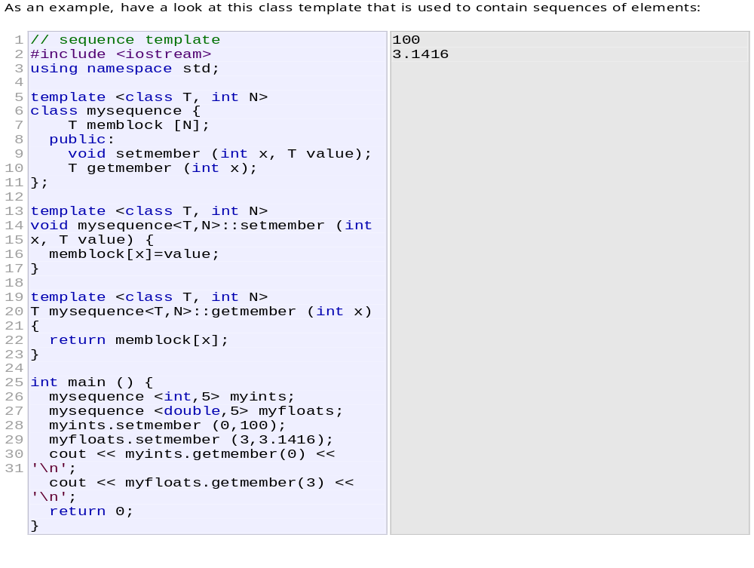
Class Templates

Slide 24
Class Templates
Features of Class Templates(contd…):
3. The name of the template argument cannot be used more than once in the template class’s list of template arguments. (See Example 18).
Example 18:
template <class T, class T> //Error
class X
{ //rest of the class
};

Slide 25
Class Templates
Features of Class Templates(contd…):
4. The same name for a template argument can be used in the list of template arguments of two different template classes. (Example 10.19).
Example 19
template <class T>
class X
{ //rest of the class
};
template <class T>
class Y
{ //rest of the class
};

Slide 26
Class Templates
Features of Class Templates(contd…):
5. The name of a template argument need not be the same in the declaration and the definition of the template class. (See Example 20).
Example 20
template <class T>
class X; //declaration
template <class U> //ok, different name for the
//template argument in the definition
class X //definition
{ //rest of the class
};

Slide 27
Class Templates
6. Formal arguments of template functions can be objects of a template class. (See Example 21).
Example 21:
template <class T>
class X
{ //rest of the class
};
template <class T>
void f1(X<T> v)
{ //definition
}

Slide 28
Class Templates
Nested Class Templates:
Nested classes can be created for template classes in the same way as they are created for non-template classes. Example 22.
Example 22:
template <class T>
class A
{
class B
{
T x;
//rest of the class B
};
//definition of class A
};

Slide 29
Class Templates
Implementing Stack in C++ using Class Template
#include<iostream>
using namespace std;
template<class T>
class stack{
T* arr;
static int top;
public:
stack(int);
void push(T);
T pop();
bool empty();
};
template<class T>
int stack<T>::top = -1;
template<class T>
stack<T>::stack(int x){
this->arr = new T(x);
}

Slide 30
Class Templates
template<class T>
void stack<T>::push(T a){
this->arr[++top] = a;
}
template<class T>
T stack<T>::pop(){
T a = this->arr[top--];
return a;
}
template<class T>
bool stack<T>::empty(){
return (top==-1);
}
void main(){
stack<int> s(10);
int i;
for(i=0;i<10;i++){
s.push(i);
}
while(!s.empty()){
cout<<s.pop()<<endl; }
}

Slide 31
Standard Template Library
The standard implementation of C++ provide a set of header files where a large number of useful class templates have been defined.
These files contain definitions of the class templates, their member functions, and a number of global associated functions. The global associated functions implement commonly used algorithms.
This library of class templates and their helper global functions is known as the Standard Template Library (STL).
The following is a list of commonly used member functions and the associated global
functions:

Slide 32
Standard Template Library
The list class
The list class is used to create sequential containers. Elements of the list are single objects. (See page 383).
For using the list template class, the header file list needs to be included in the source code: #include<list>
The elements of a list occupy a non-contiguous memory. They are doubly linked through a pair of pointers. One of the pointers points at the next element and the other points at the previous element of the list. This allows both forward and backward traversal.
The number of elements a list object would have can be specified at the time of declaration. (See page 383).
A default value can be specified for these elements. (See page 383).
A list can be created from an existing array. (See page 383).

